Slide 1





ASSESSMENT
Vaishnavy prakash
U-id: 168225

Slide 2
Task 1
Write a single shell script where it has to perform the below operations by taking user inputs
Create a file and directory
Delete a file and directory
Retrieve specific data from a given sample data file
Append data to the sample file at a particular requested row.
Modify data in the file
All the above should be available like options and based on the selection the necessary action should be taken.

Slide 3
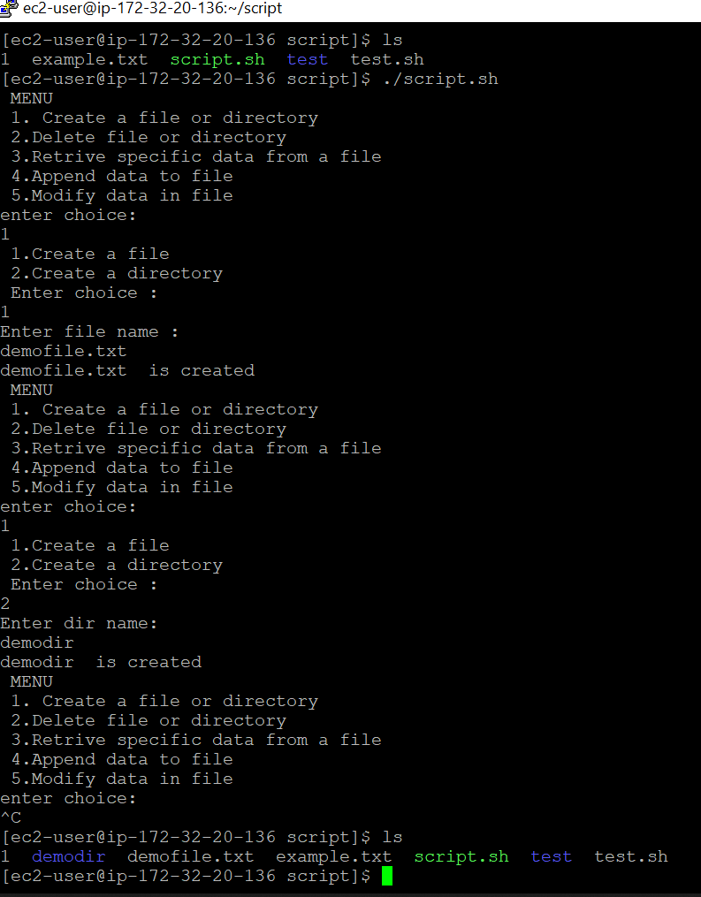




Here, after running the script ./script.sh -The menu is displayed with five options -The first option of creating the file and the directory is selected. -Inside that first option there are two option , creating a file and creating a directory -creating a file is selected : file name → demofile.txt -creating a directory is selected : dir name → demodir -then ‘ls’ command is executed to check if the files and directory are created.

Slide 4
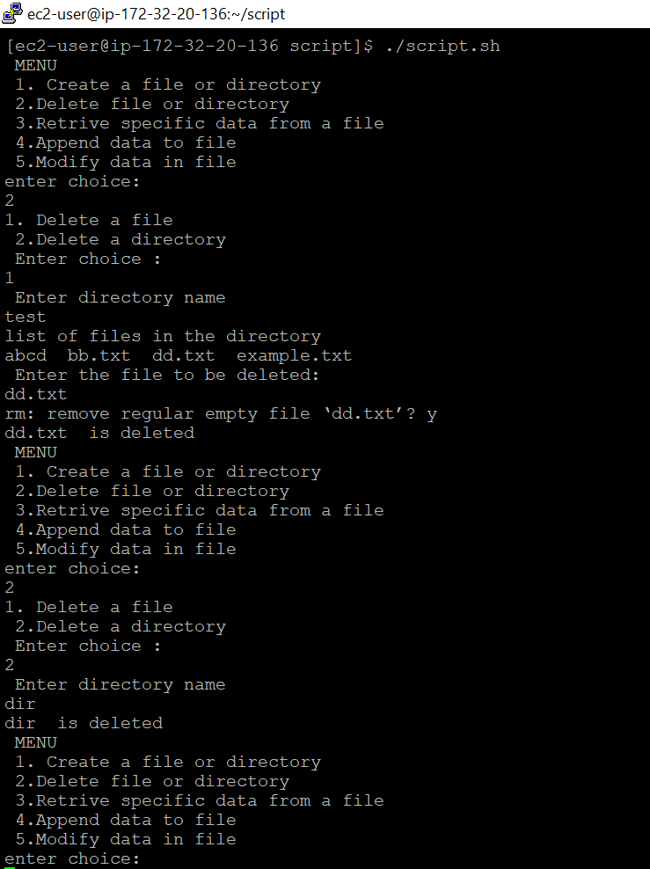
Second option to delete a file or directory - under this, first option is to delete a file. So, we give a dir name first after which it displays the files under this dir. Based on the input file name the script deletes that file. - Next the directory delete option is selected and the directory name is given and then the dir directory is deleted.

Slide 5
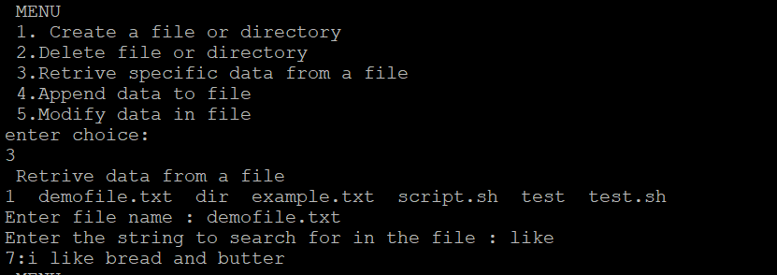
Here option three is for retrieving a specific data from a file. In that I need enter the file name, for example demofile.txt and next I gave a string that has to be retrieved Ex: “like”, so it displays back the line number and the string that I searched for.

Slide 6
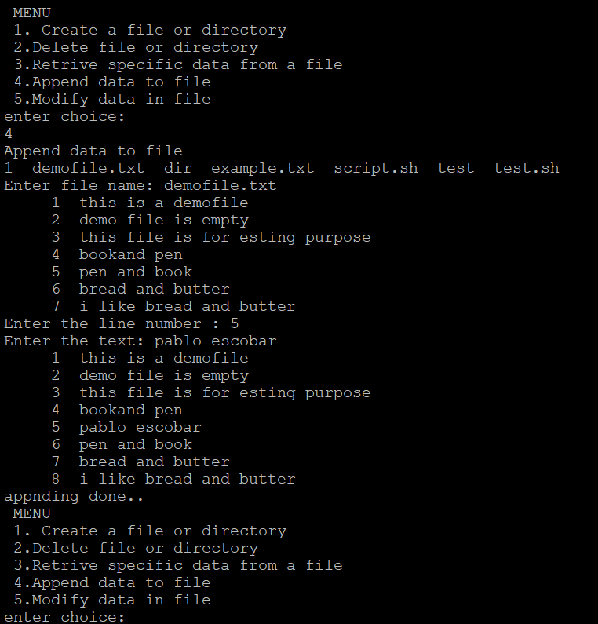
Option 4 is to append data to a file . File name, line number and text has be given as inputs. So the file gets appended with the data provided.

Slide 7
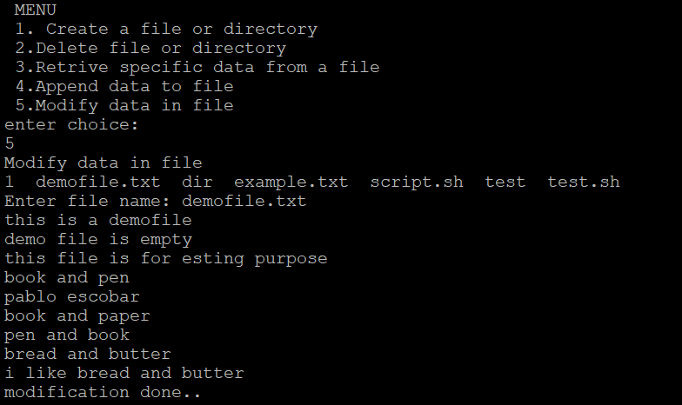
Here option 5 is selected and it directly opens the vim editor and you can directly modify the file and the cat command will show the modified file.

Slide 8
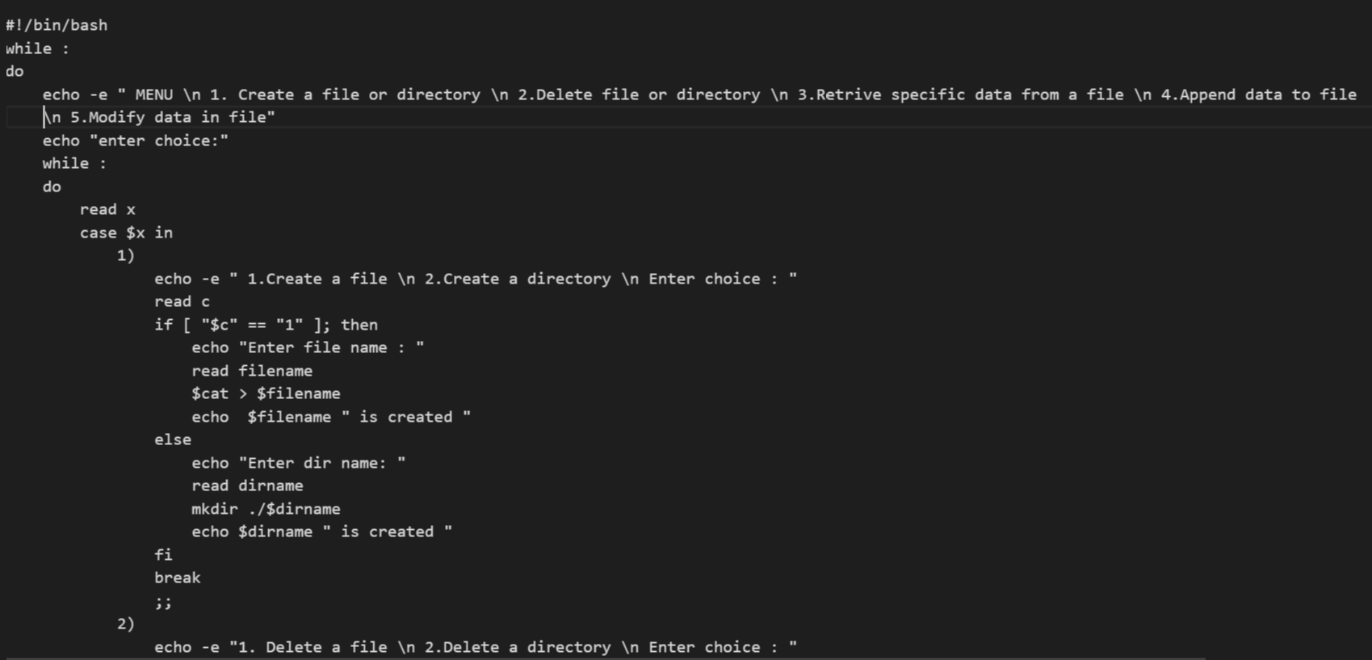
Script

Slide 9
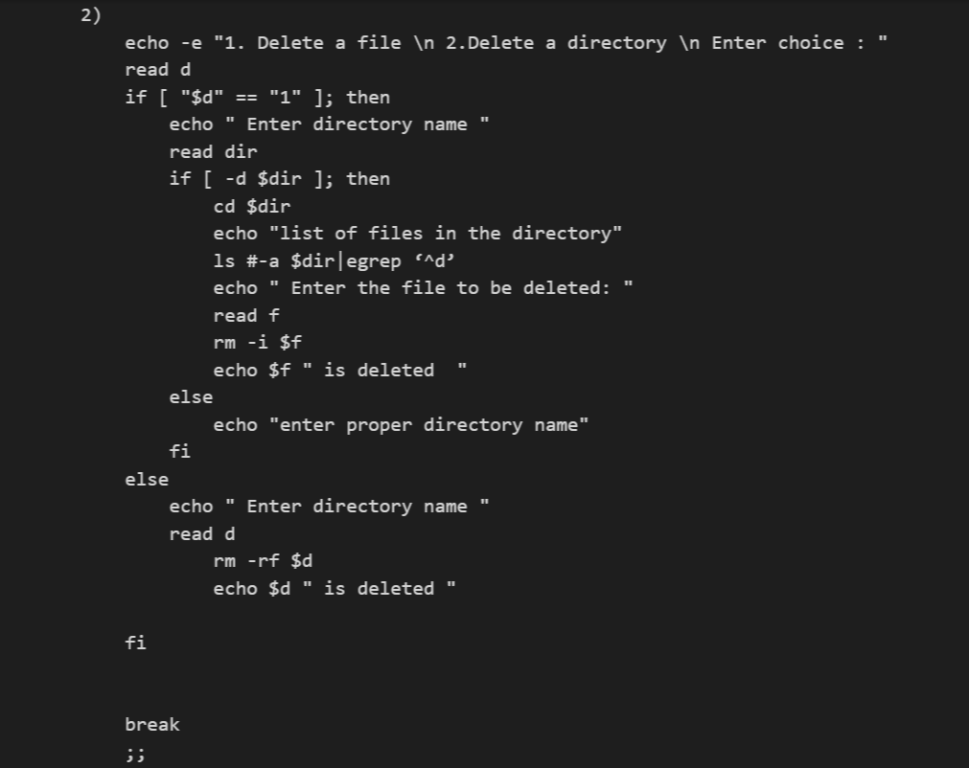
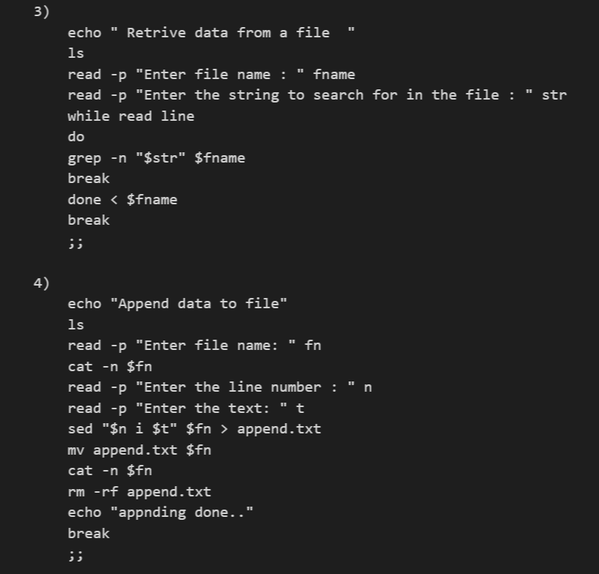

Slide 10
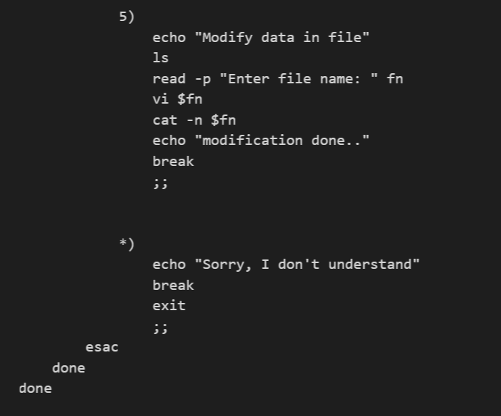

Slide 11
Task 2
Install Ansible in the EC2 machine provided
Install Java, python and apache2 in ec2 using ansible playbook. Modifications needs to be done for the apache2 using ansible playbook, so that when <ip>:<port number> is entered in the webserver it should display default page.
Add a new task to the playbook where repo from GitLab need to be cloned to cloned to local machine. This repo consists of ‘index.html’ file and this need to be copied to apache2 /var/www/html/ path using ansible.
The apache2 service needs to be restarted. Once restart is done, check the status of the service. This is also done using ansible.
When the web console is reloaded the new page should be displayed.

Slide 12
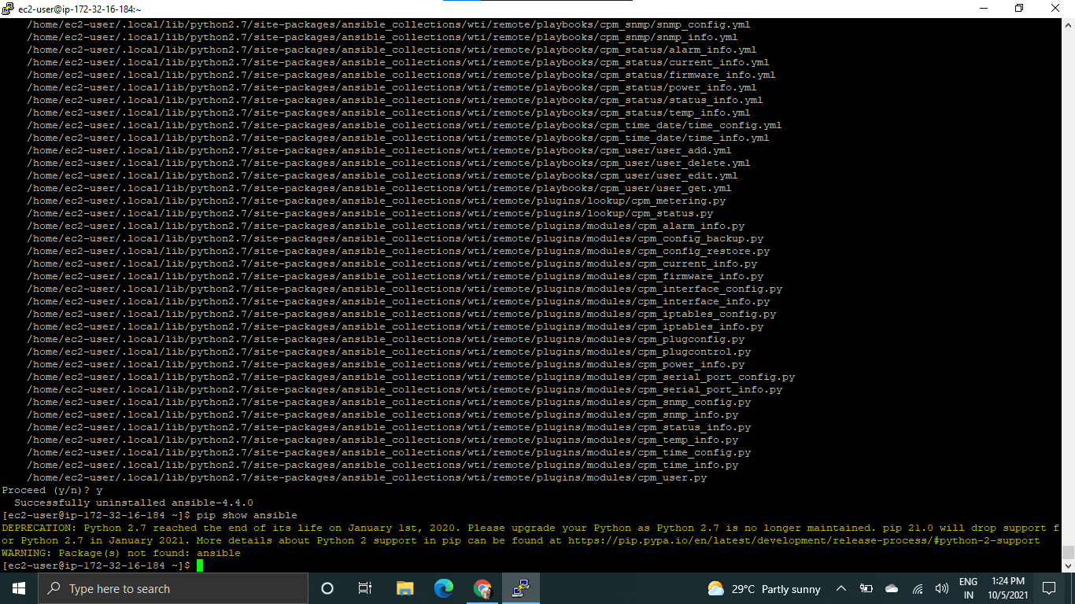
Here , in the ec2-instance ansible was already installed by me. By using the command : ‘pip uninstall ansible’ I uninstalled the Ansible. Then with the command: pip show ansible, I Checked if the ansible is still there or not. As you can see Ansible is uninstalled.

Slide 13
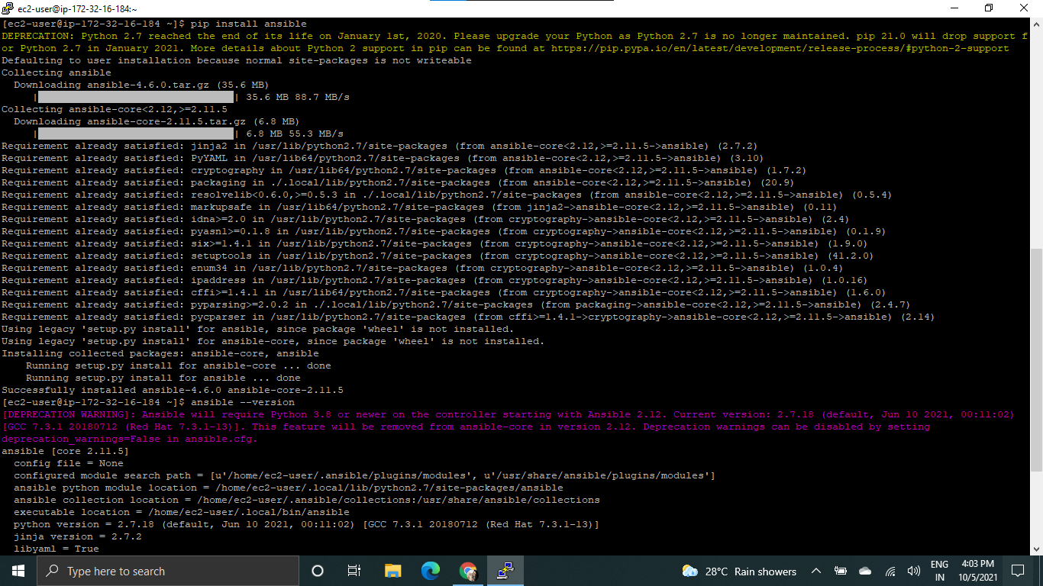
Here, I installed ansible using command : ‘pip install ansible’ Ansible successfully installed. Then checked the version using the command : ansible –version. Version is 2.11.5 is returned .

Slide 14
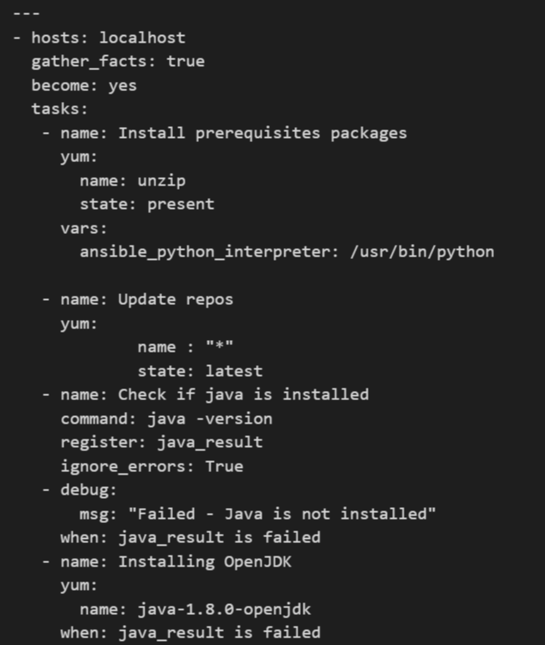
Playbook -1

Slide 15
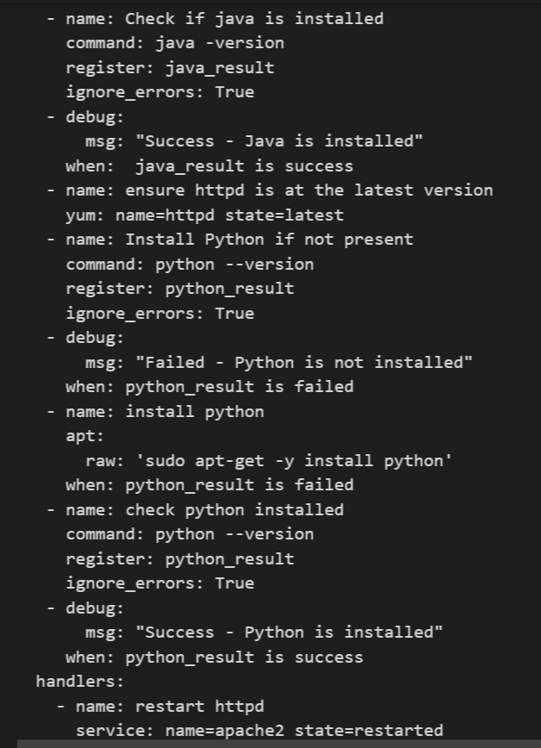

Slide 16
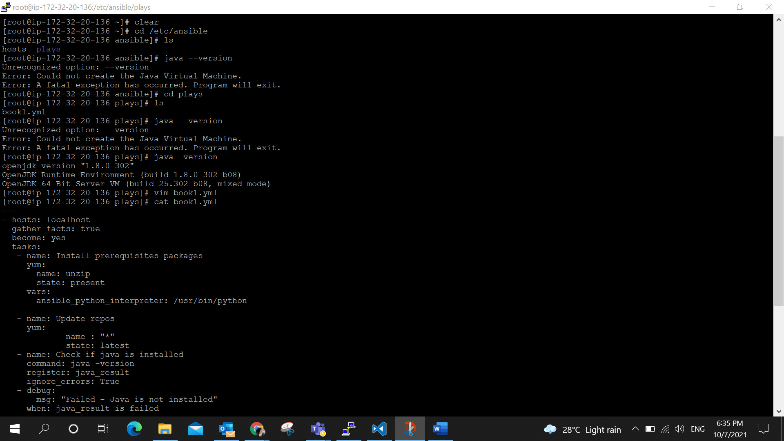
Here, installing java, python and httpd(apache2 ) is done. In the playbook that is displayed in the screenshot the step is in this way that if java or python is pre-installed that installation will be skipped, and it proceeds to installing httpd.

Slide 17
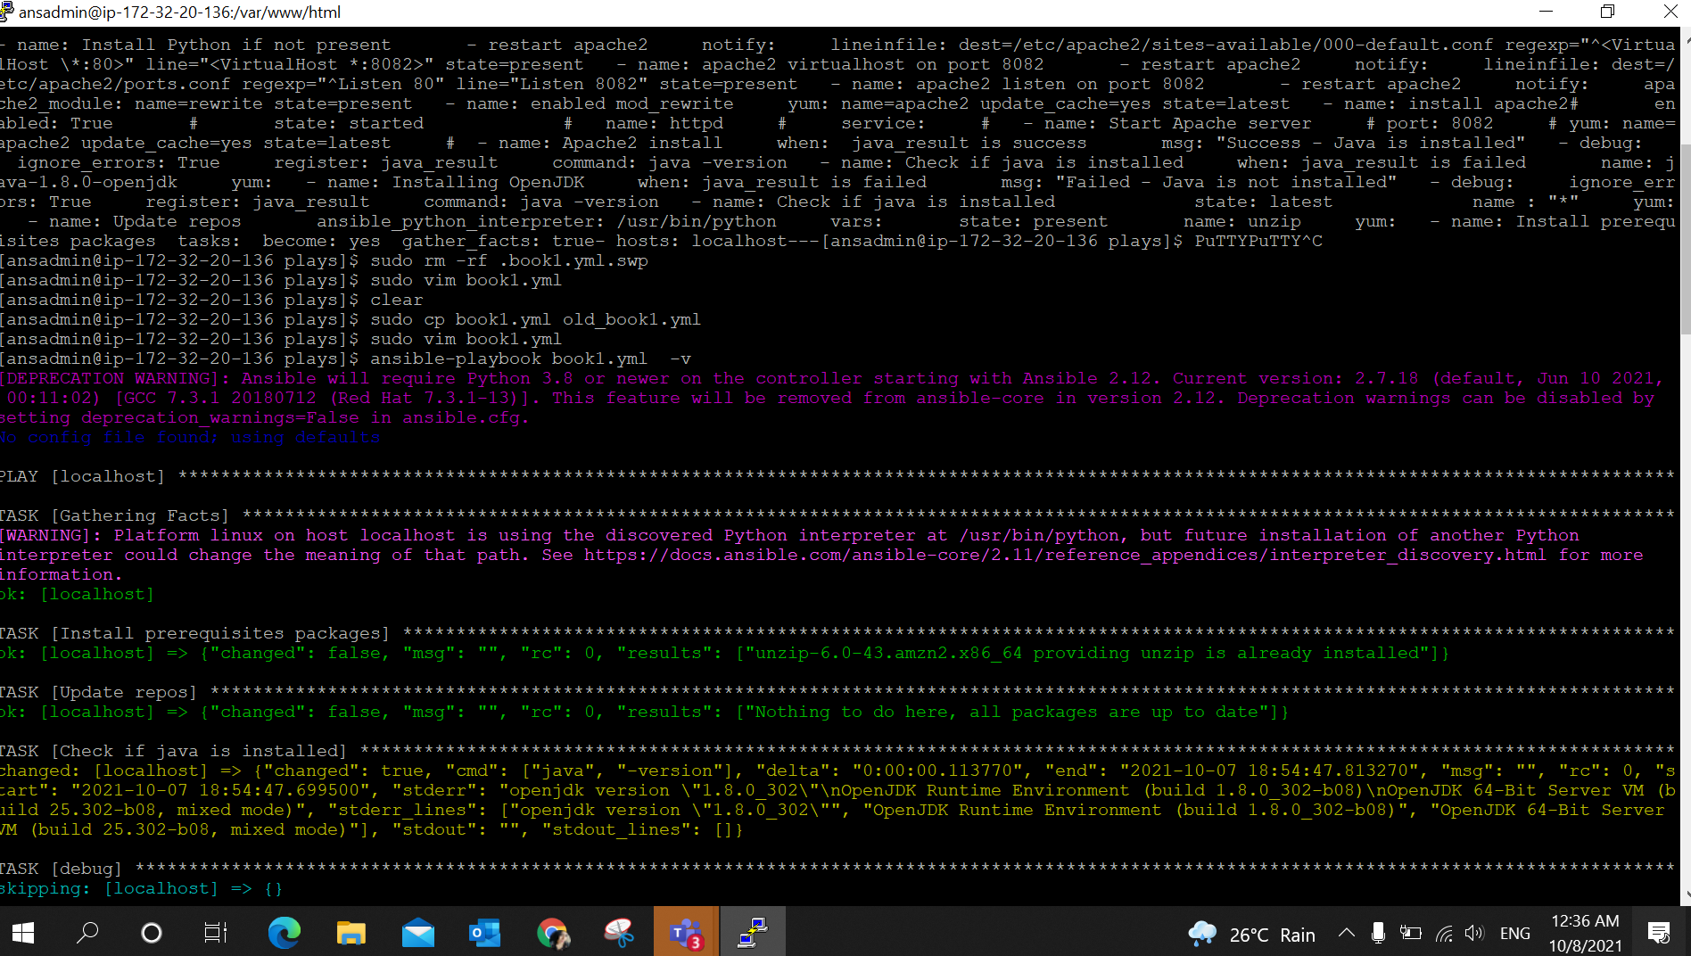
The playbook is ran using the command : ansible-playbook book1.yml

Slide 18
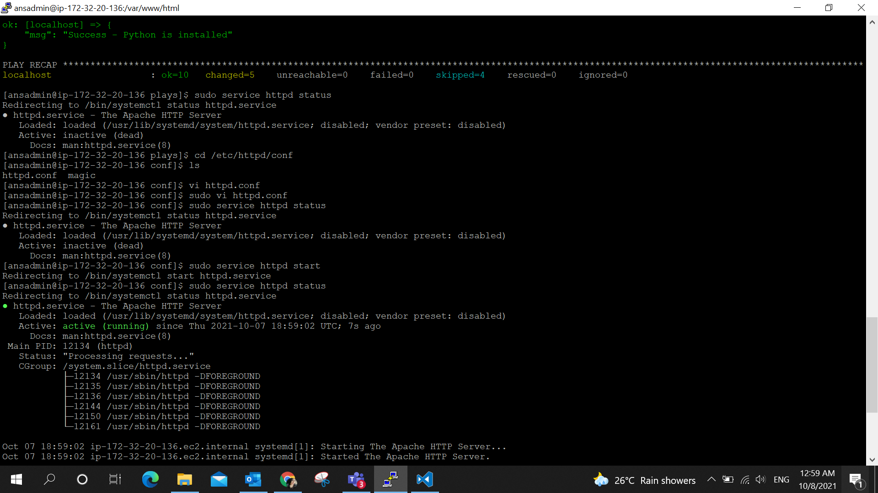
Once the playbook was successfully executed . Checked the http service using the command : sudo service httpd status. It was inactive. Then changed the port by going to the httpd.conf file and started the service with ‘ sudo service httpd start ‘. Now it is active and running in port 8082, as shown in picture below.

Slide 19
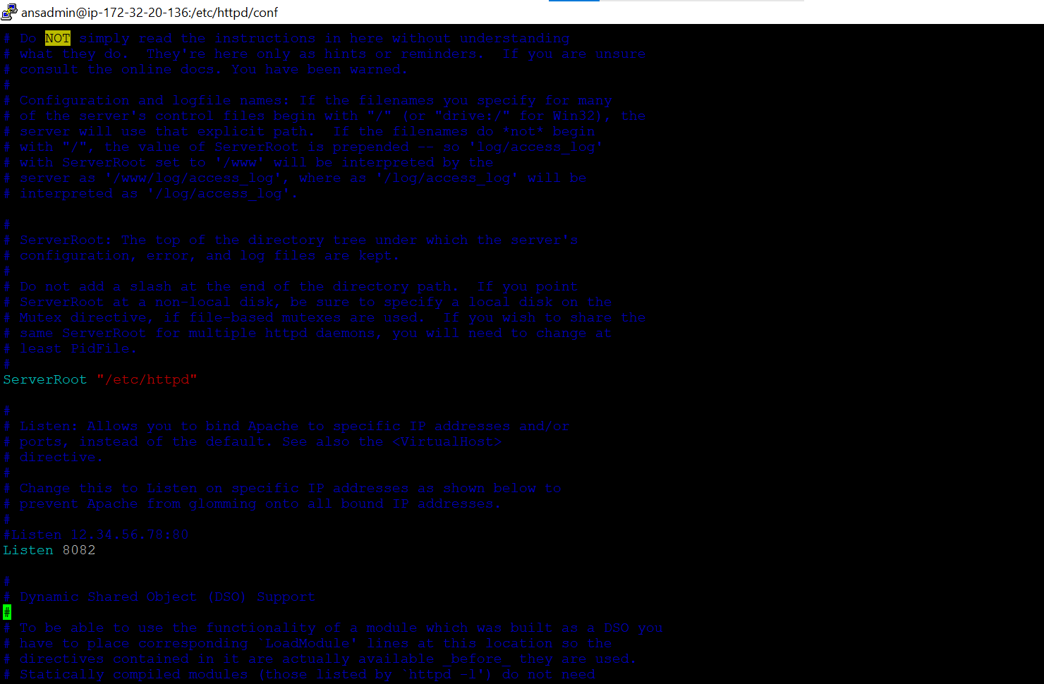
Changes made to the httpd.conf file

Slide 20
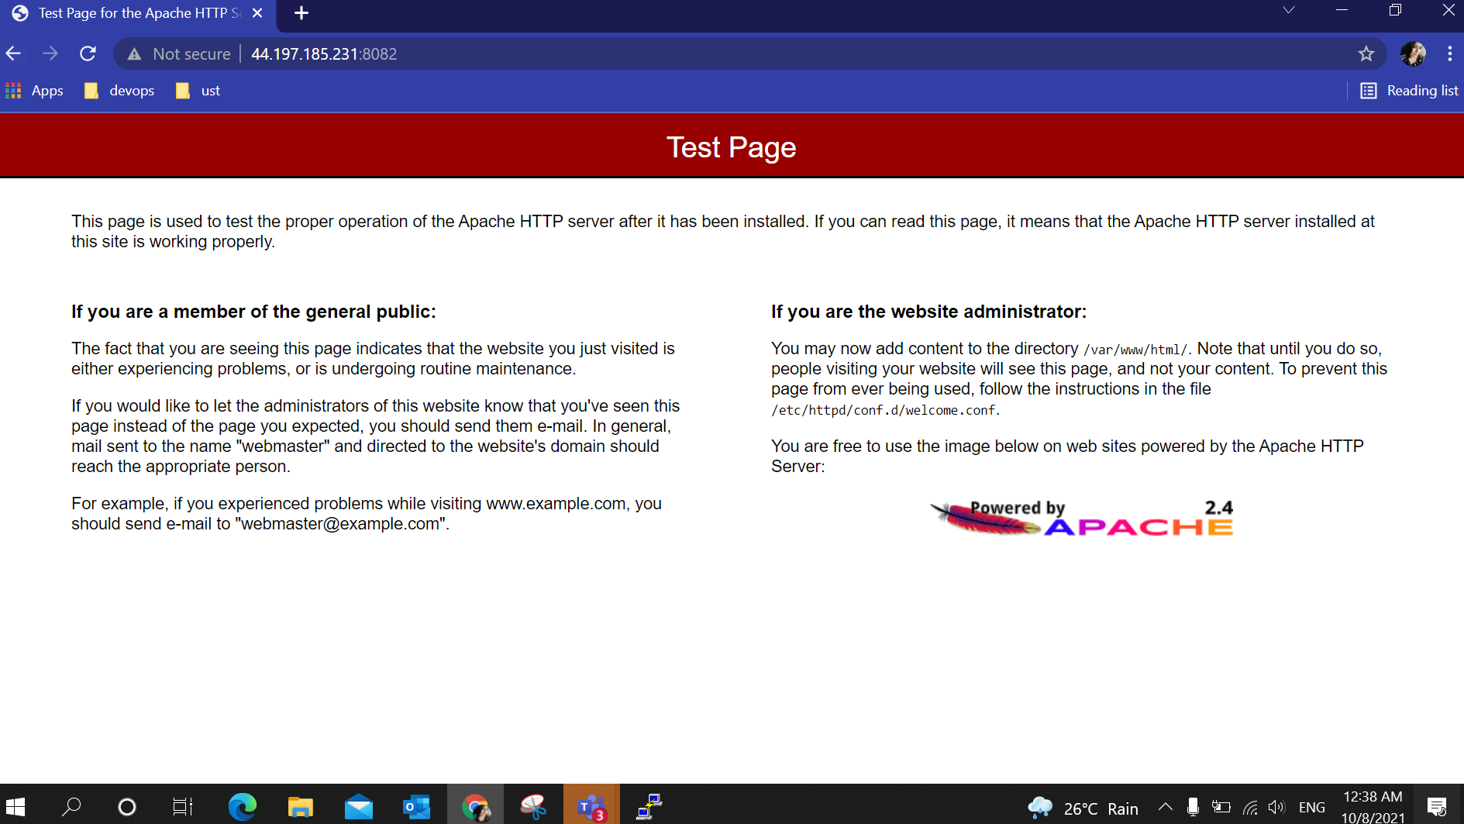
Apache test page is running in port 8082

Slide 21
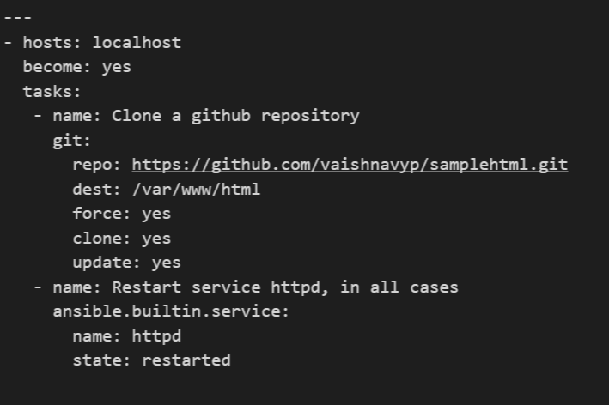
Playbook-2

Slide 22
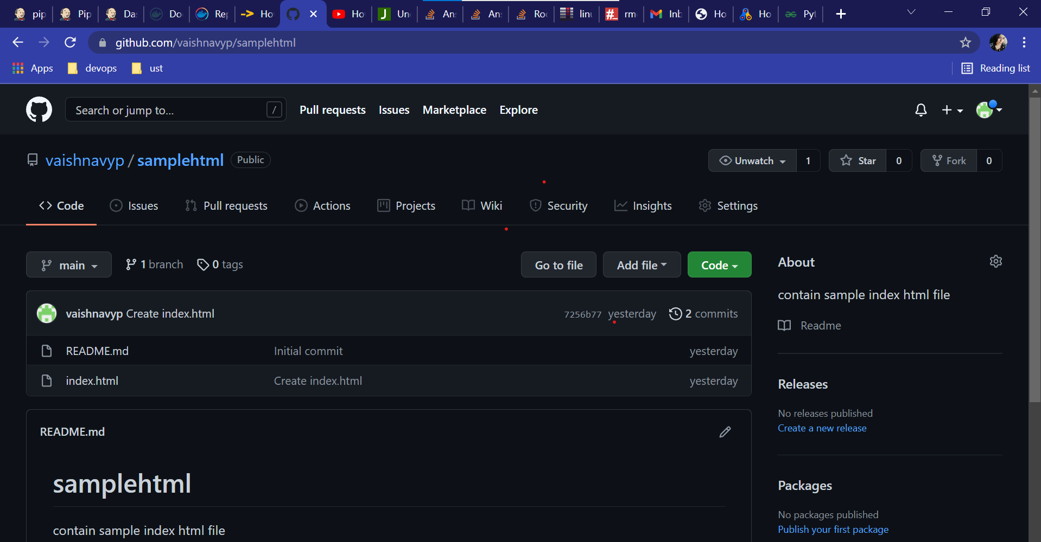
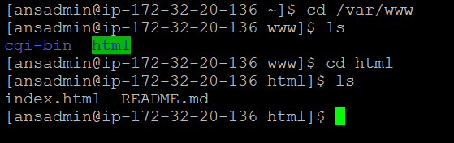
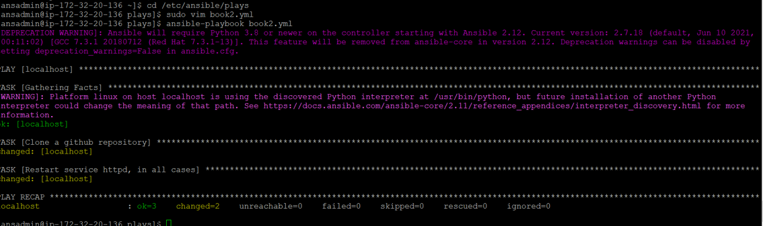
Ran a playbook where the repo from my gitlab account is cloned to local machine. This repo consists of ‘index.html’ file and this is copied to httpd /var/www/html/ path and the httpd service is restarted .

Slide 23
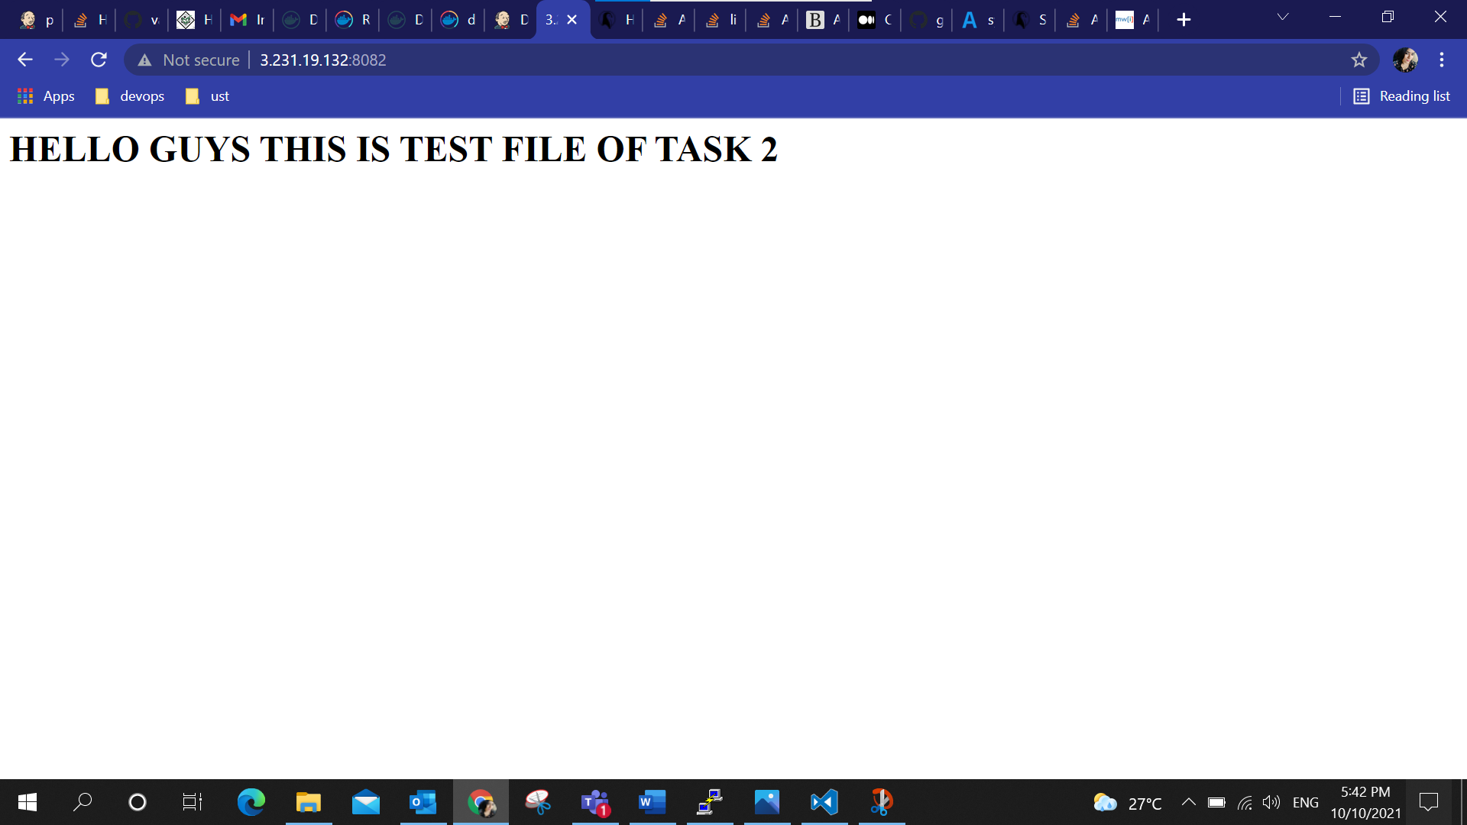
Now the html page is reloaded and new index.html that was cloned from the repo is listening on port 8082 with the updated content.

Slide 24
Task 3
Install Docker in EC2 machine provided
Make the service up and check the docker version
Write a docker file (use Centos) to install Jenkins and necessary pre-requisites required for Jenkins to run.
Create an Image using this docker file and image name should be ATeam-Jenkins-<Trainee_Name>
Push it to docker hub
Create two containers with names JenkinsOne and JenkinsTwo, where these two containers should be running on ports 8082 and 8090 and the same need to be mapped with the host VM.
So when we give <host_ip>:8082 in Web console JenkinsOne should be accessed and when <host_ip>:8090 is given JenkinsTwo should be access
A pipeline need to be created in Jenkins where it should clone a repo from gitlab to host machine.

Slide 25
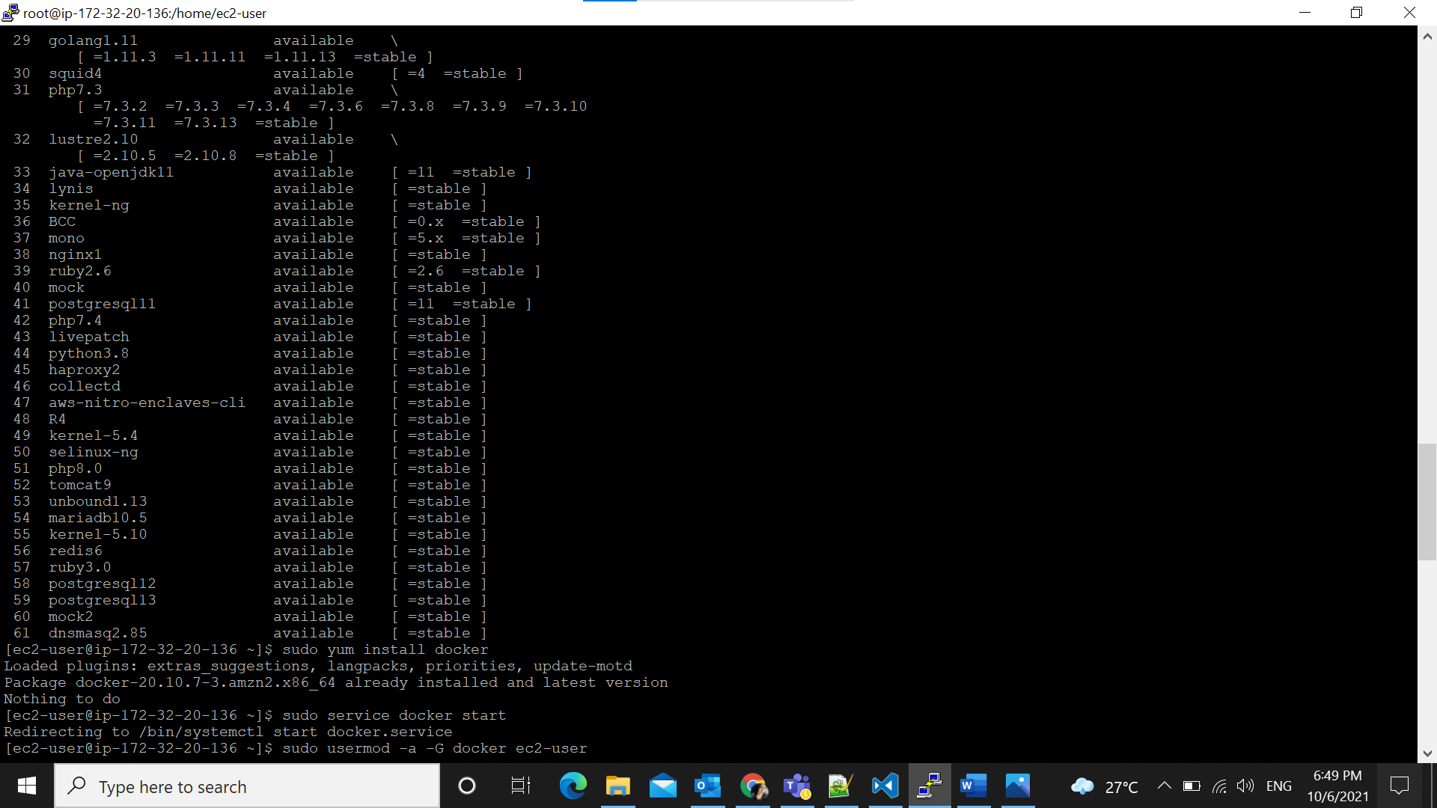
Installed Docker using the command: sudo amazon-linux-extras install docker and then start the docker service using the command : sudo service docker start. checked the version using the command : docker --version

Slide 26
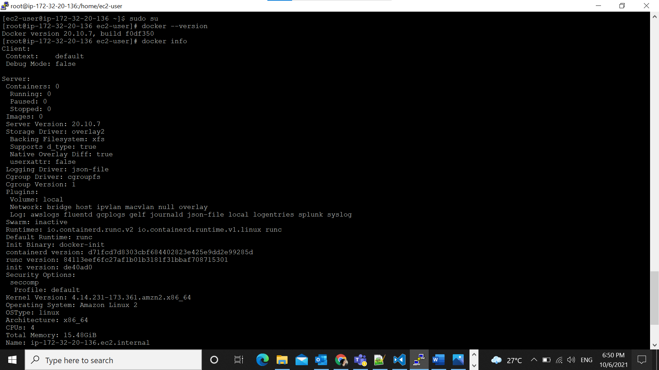
Checked the command docker info

Slide 27
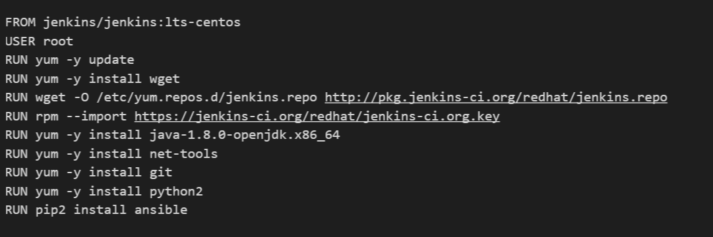
Docker file

Slide 28
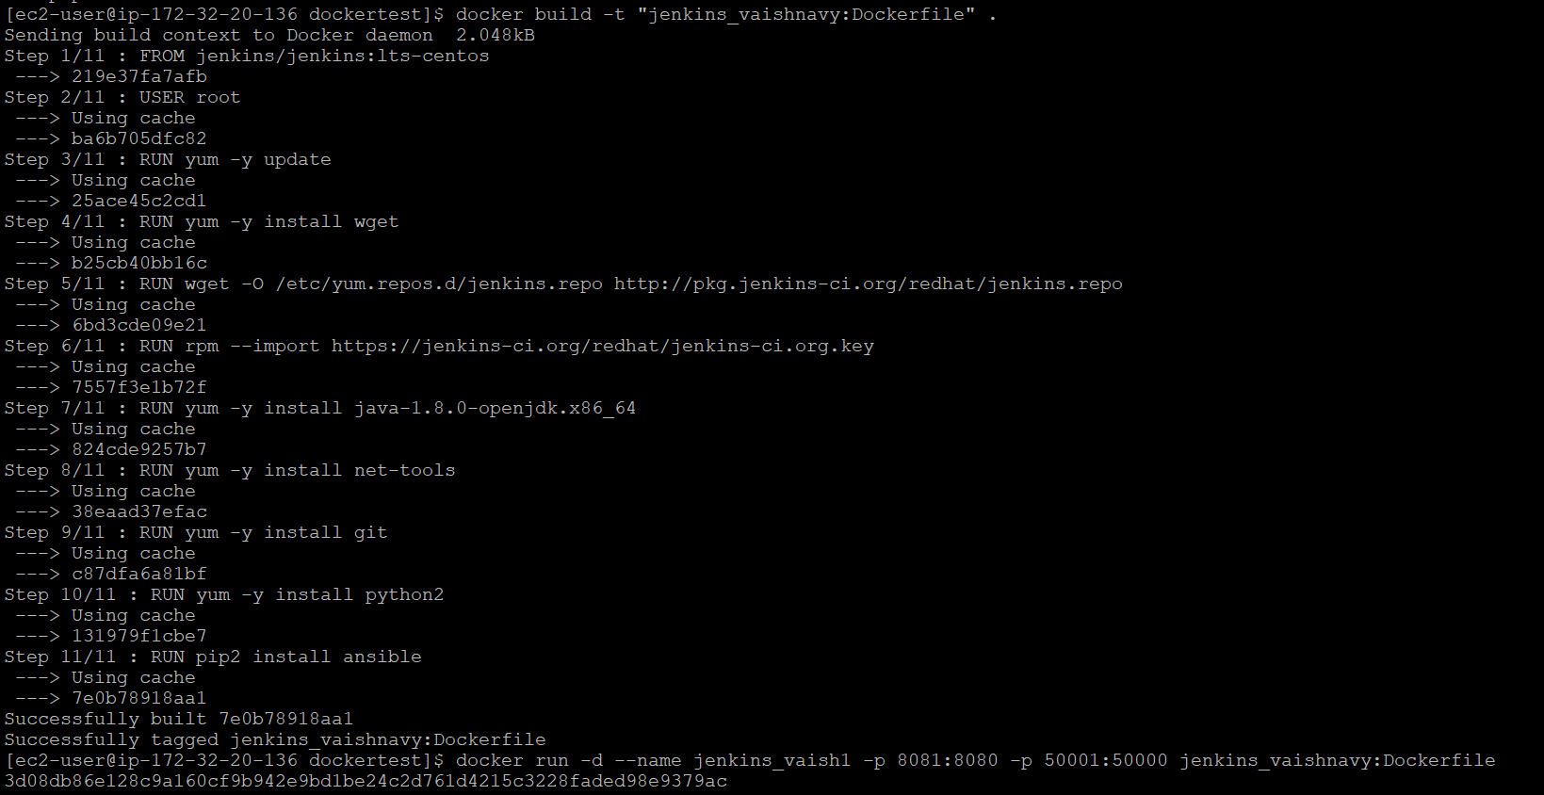
Building the Dockerfile and running it in port 8081 – As you can see the container 1 (Jenkins container) running in 8081 port The commands used to build and run the container : → docker build -t “jenkins_vaishnavy:Dockerfile” . → docker run –d --name Jenkins_vaish1 -p 8081:8080 –p 50001:50000 jenkins_vaishnavy: Dockerfile

Slide 29
After the container is up and running the initial Admin Password is to be provided at first . For that I used the command : docker exec –it <container_id> bash and cat /var/Jenkins_home/secrets/initialAdminPassword to get the password to access Jenkins.

Slide 30
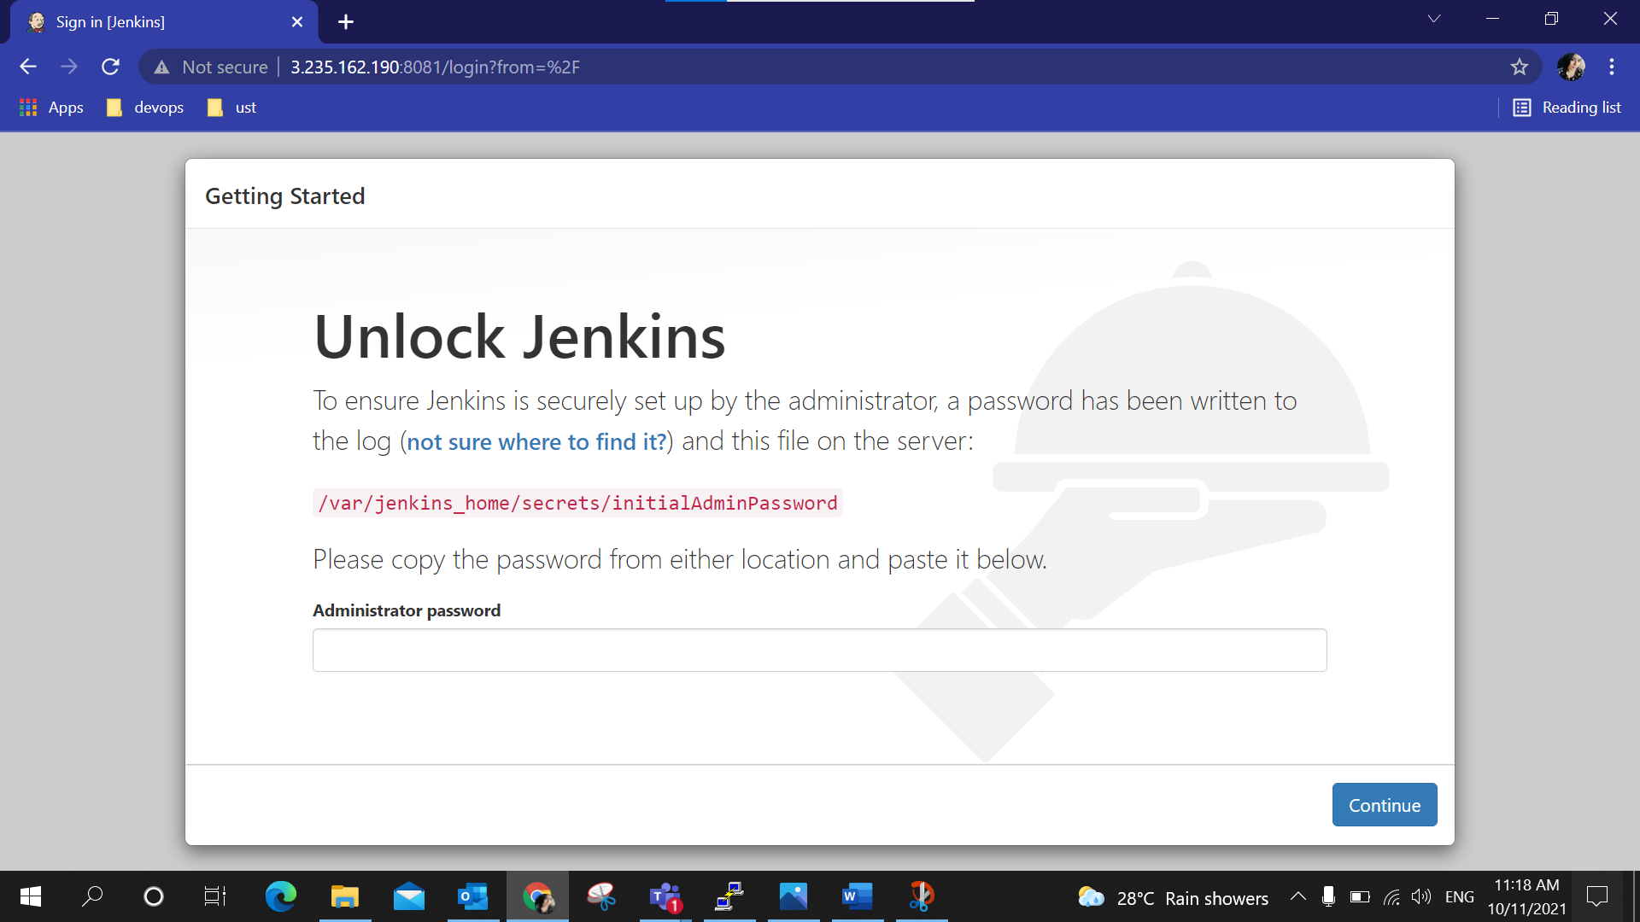
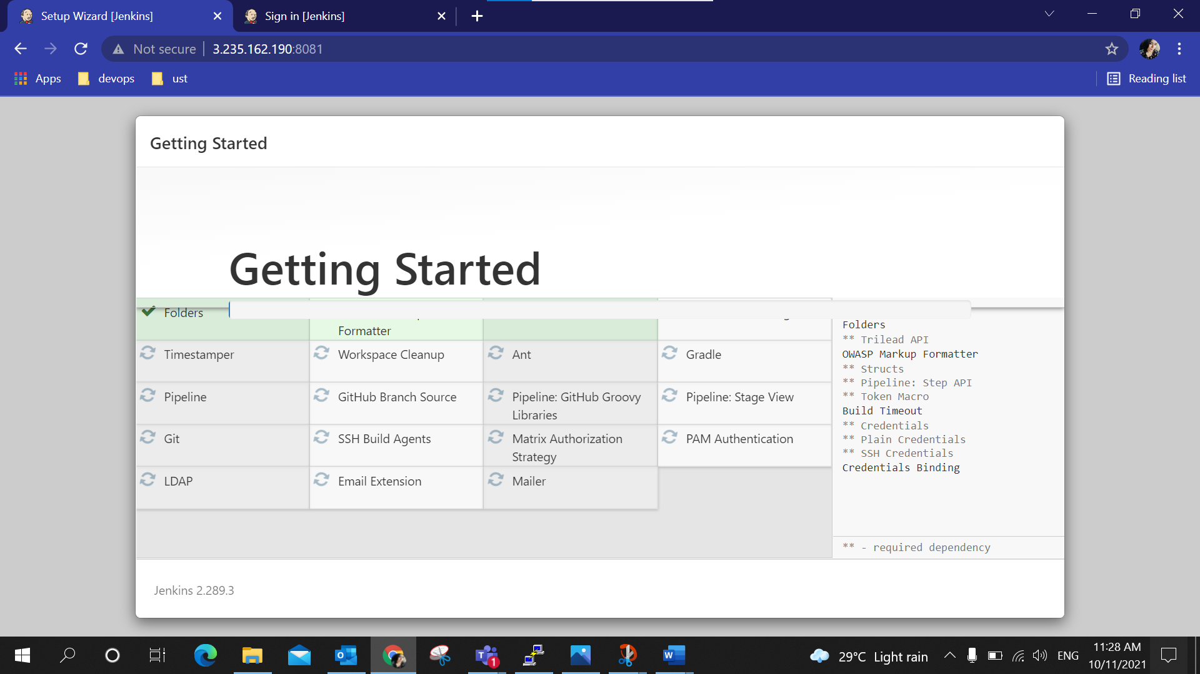
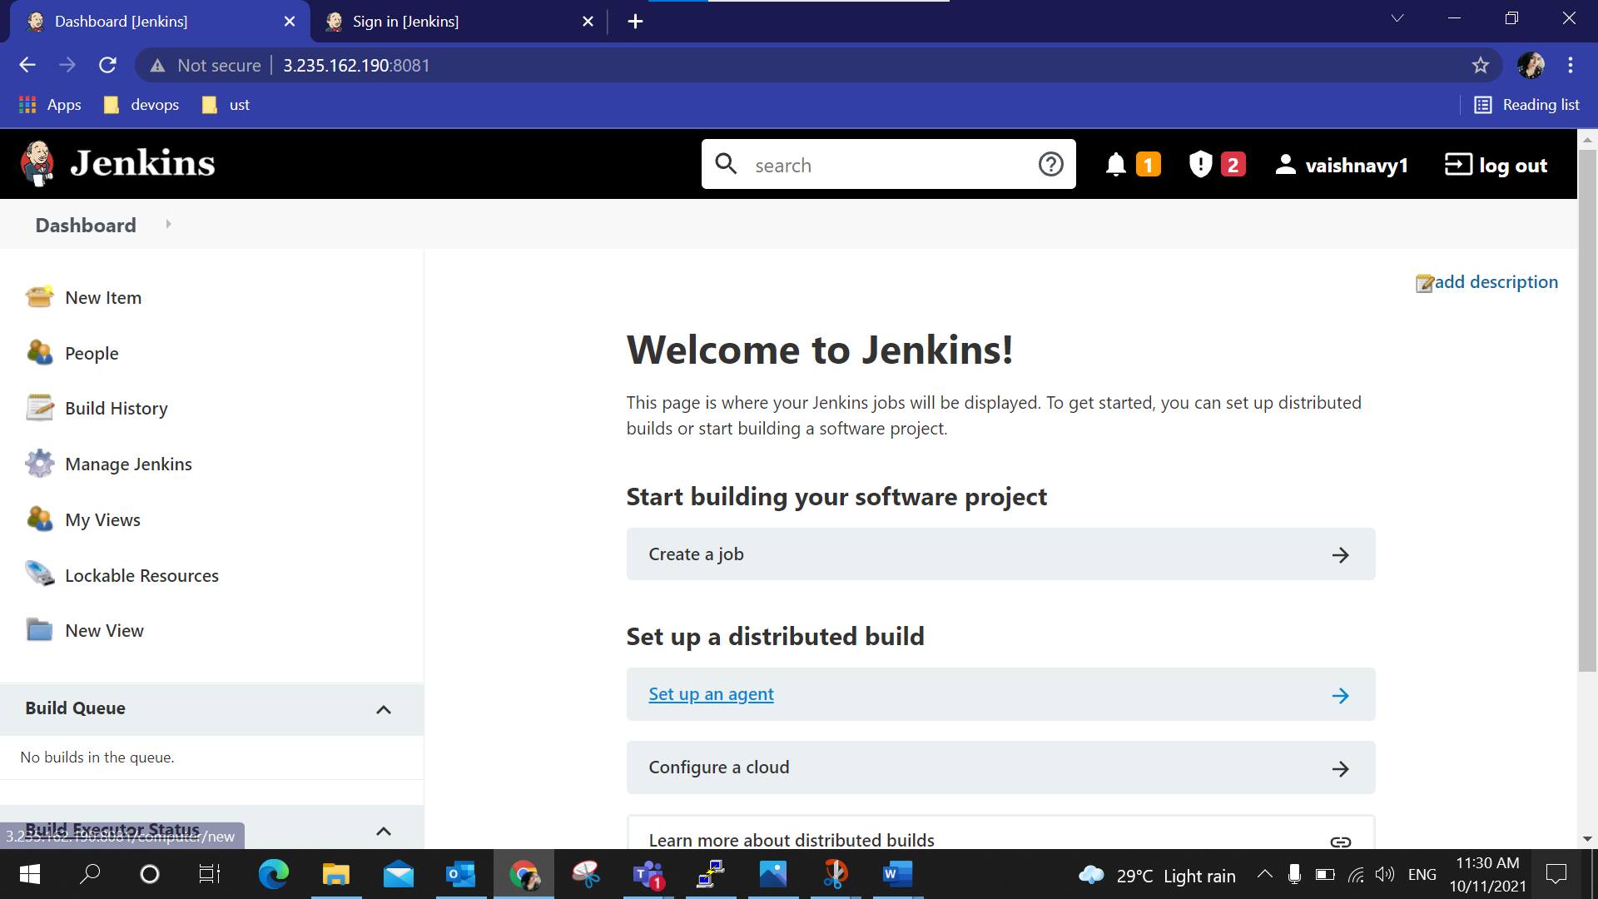
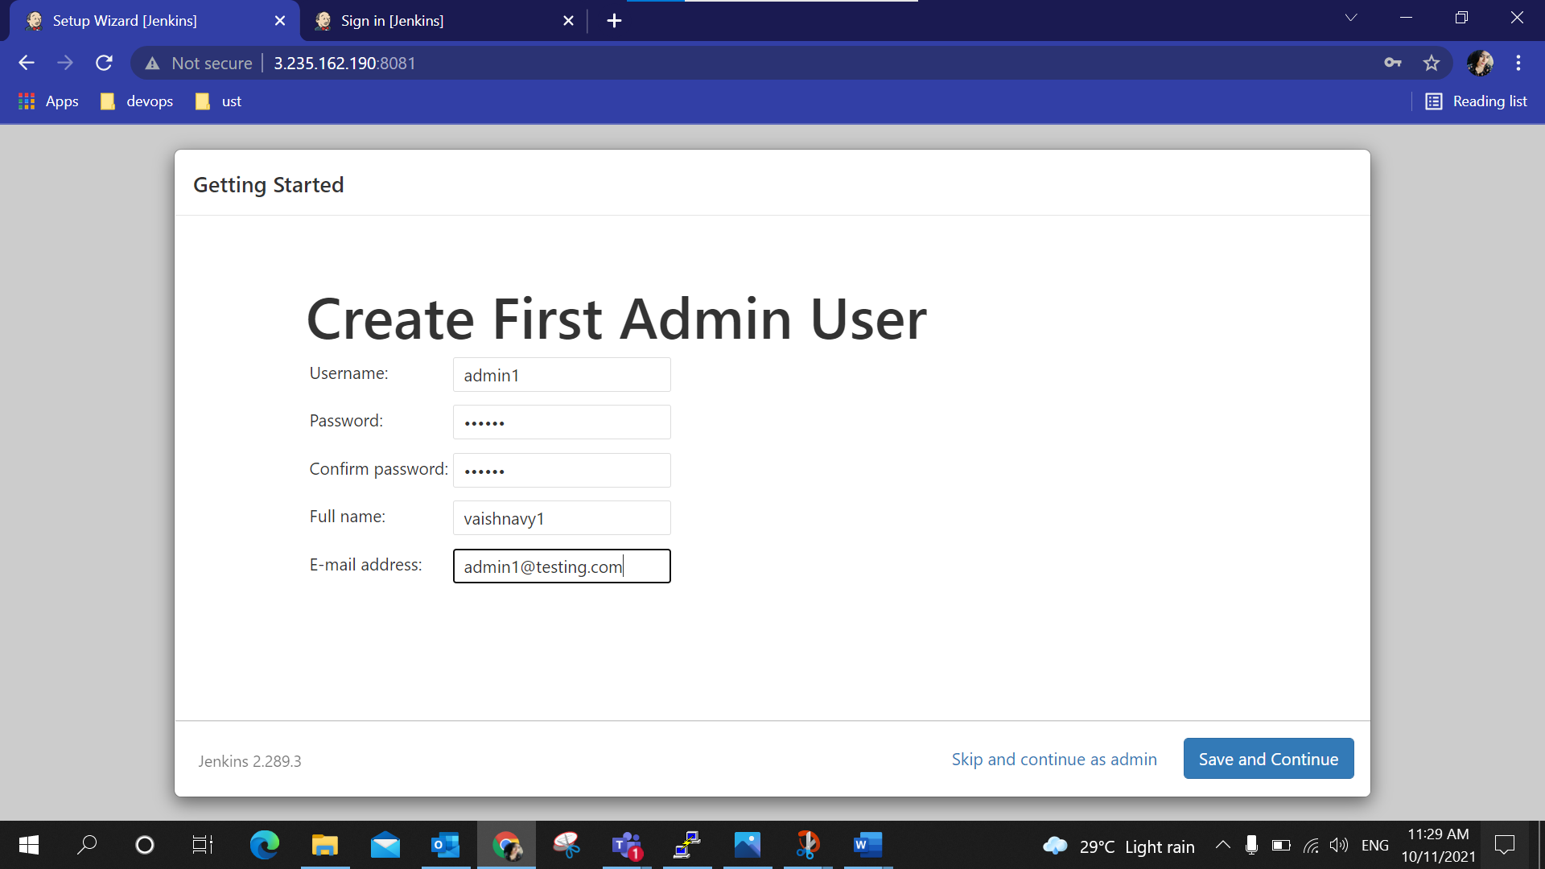

Slide 31
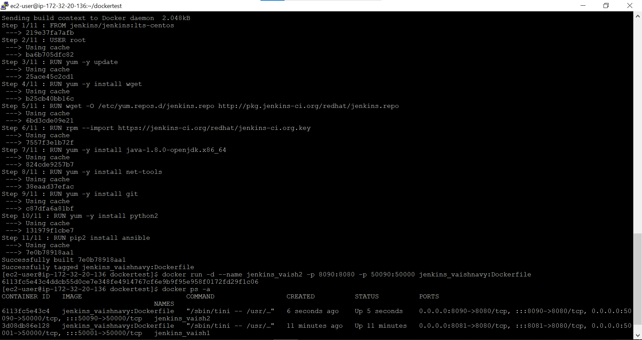
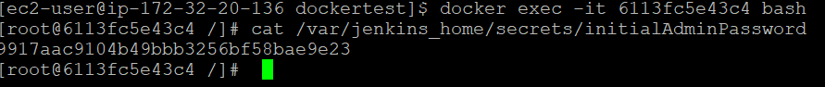
Building the docker file and running the container 2 in port 8090

Slide 32
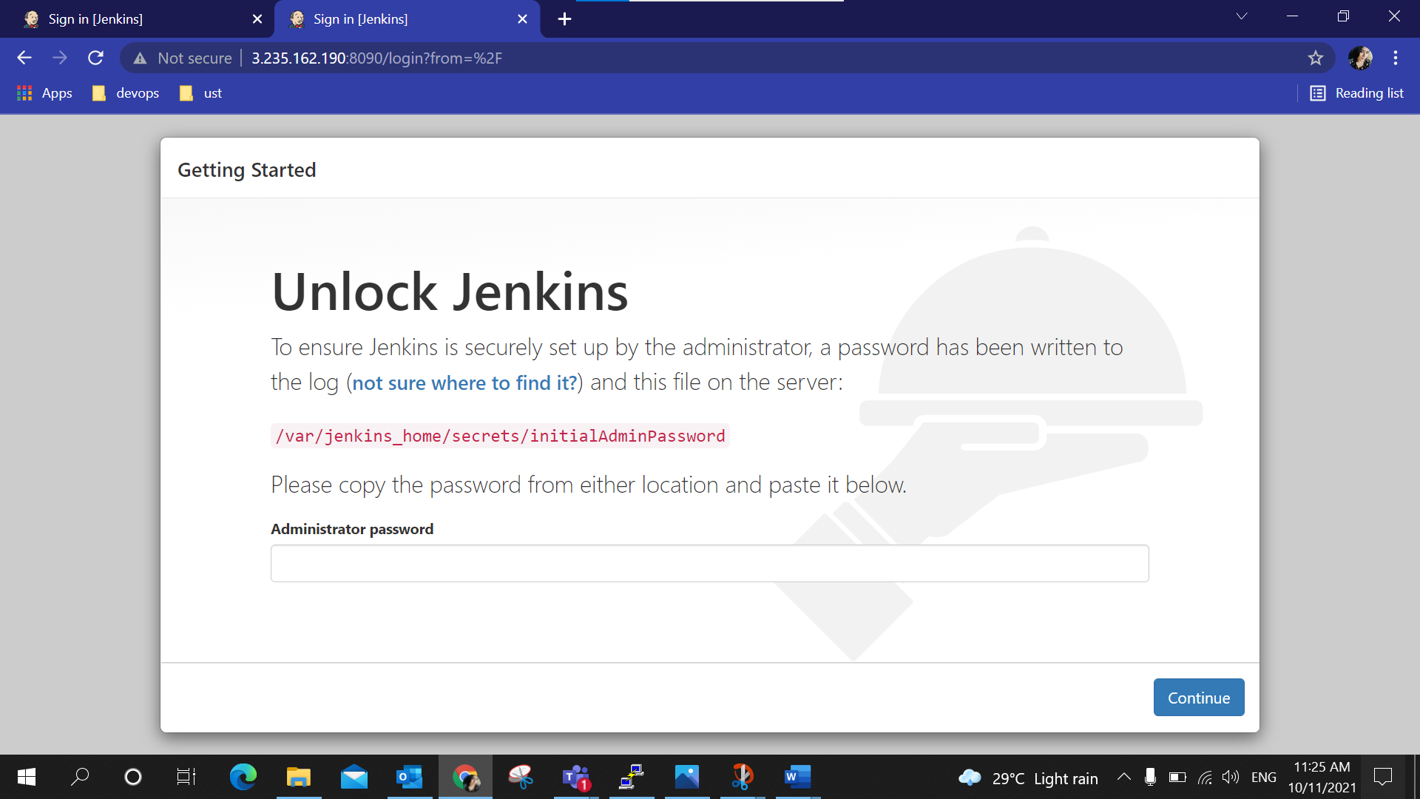
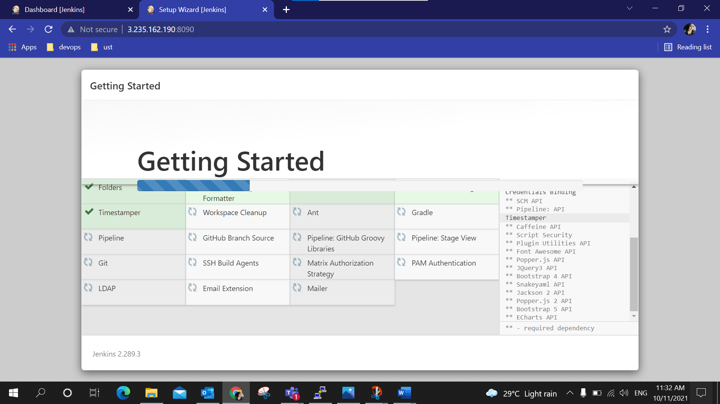
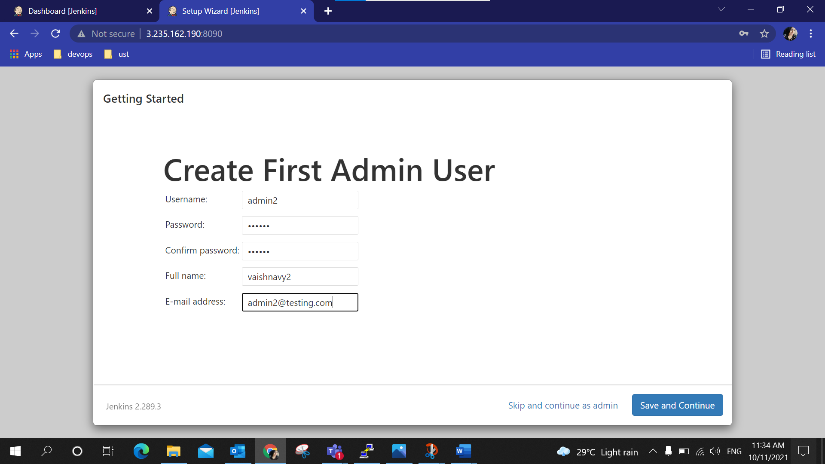
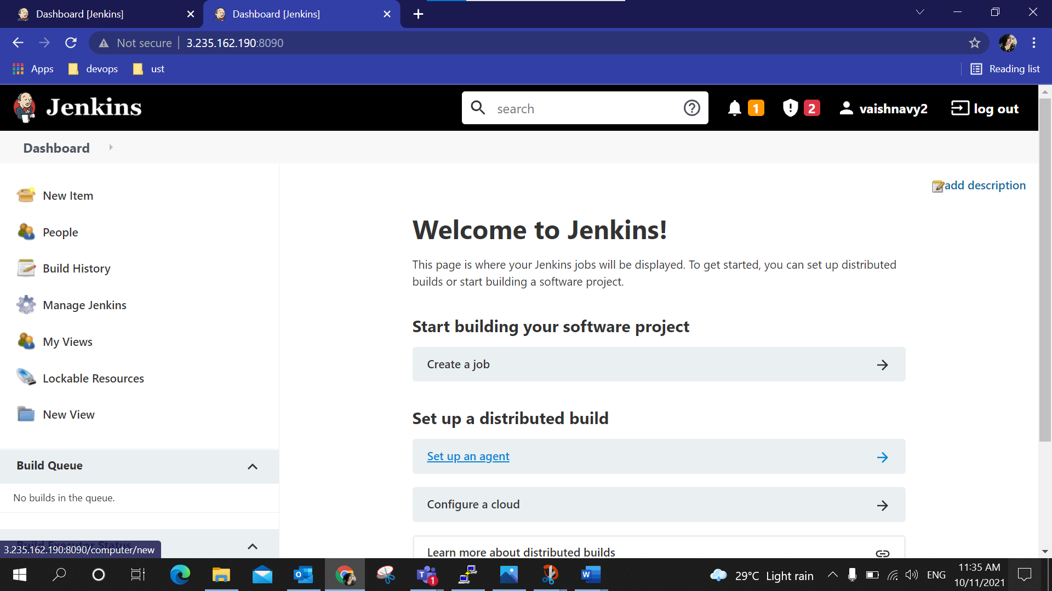

Slide 33
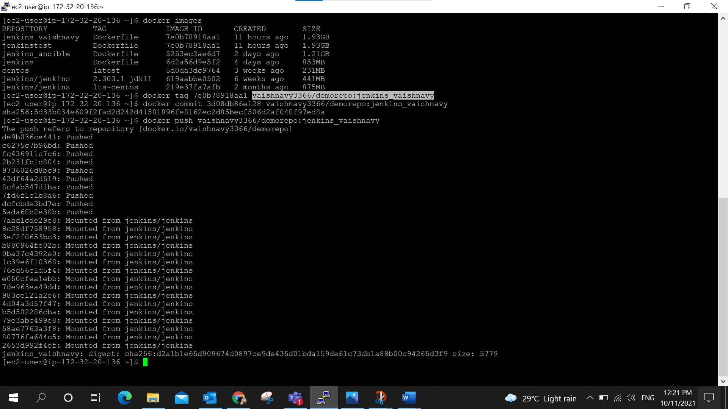
Pushing to docker hub

Slide 34
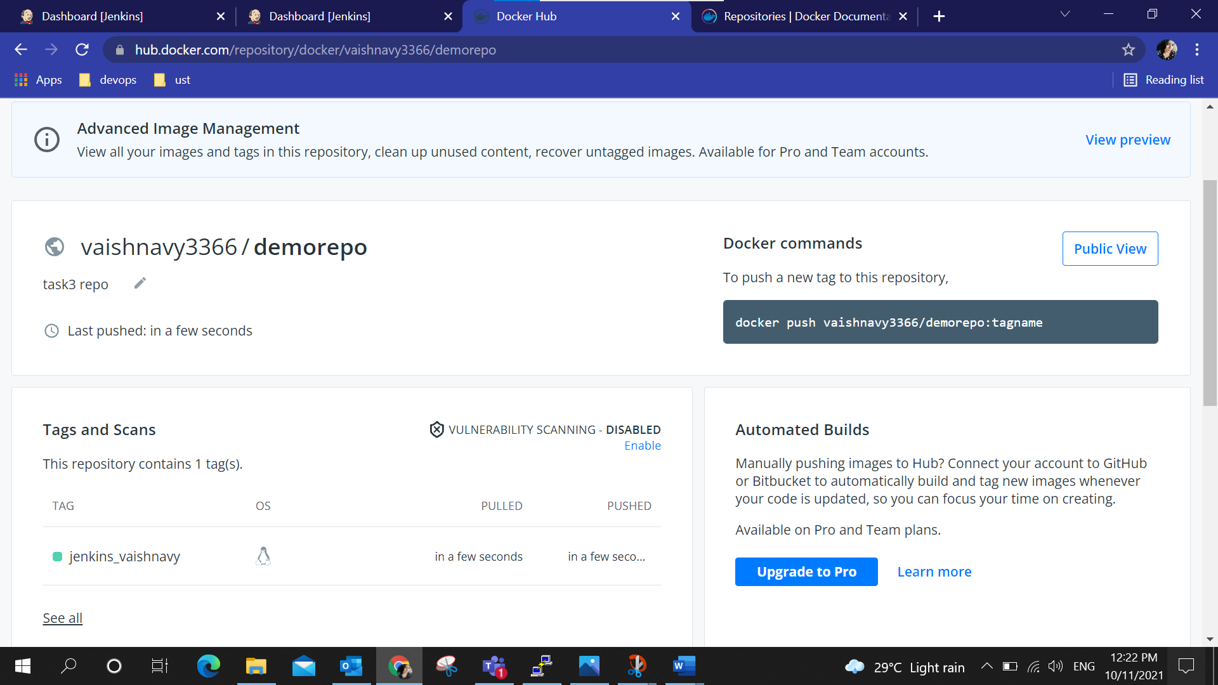
Image is now pushed into the docker hub

Slide 35
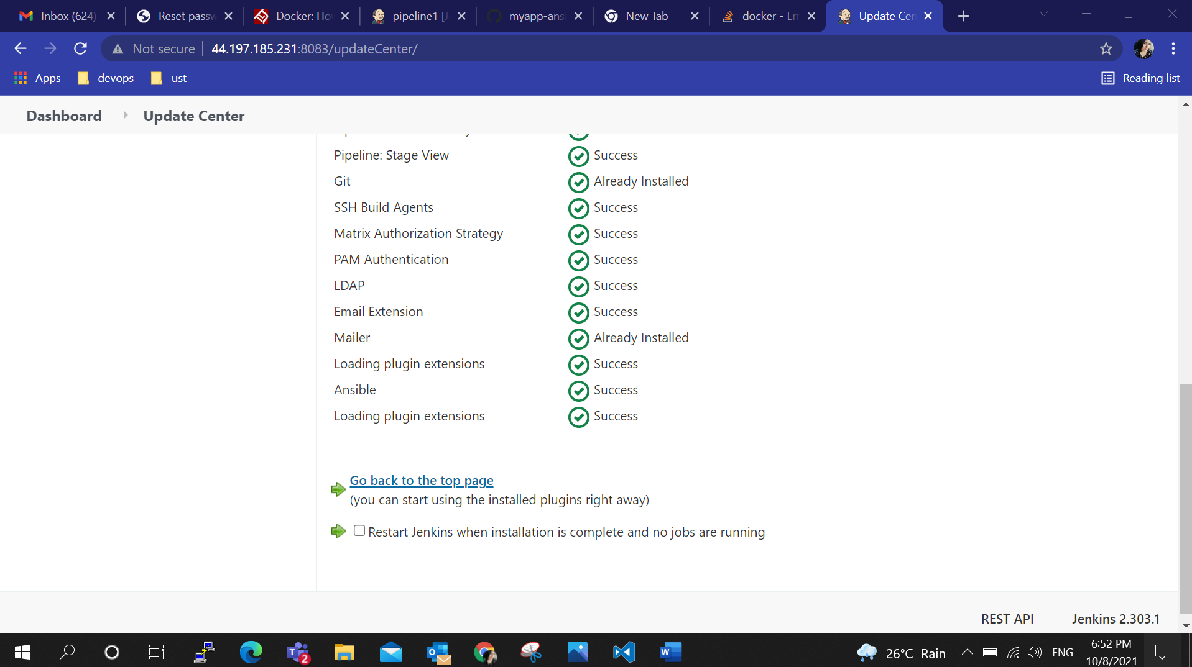
In Jenkins, I installed ansible and docker plugins and the path is set in Global tool configuration. A new pipeline job is created and the pipeline script is written to clone the repo from git hub to the local machine

Slide 36
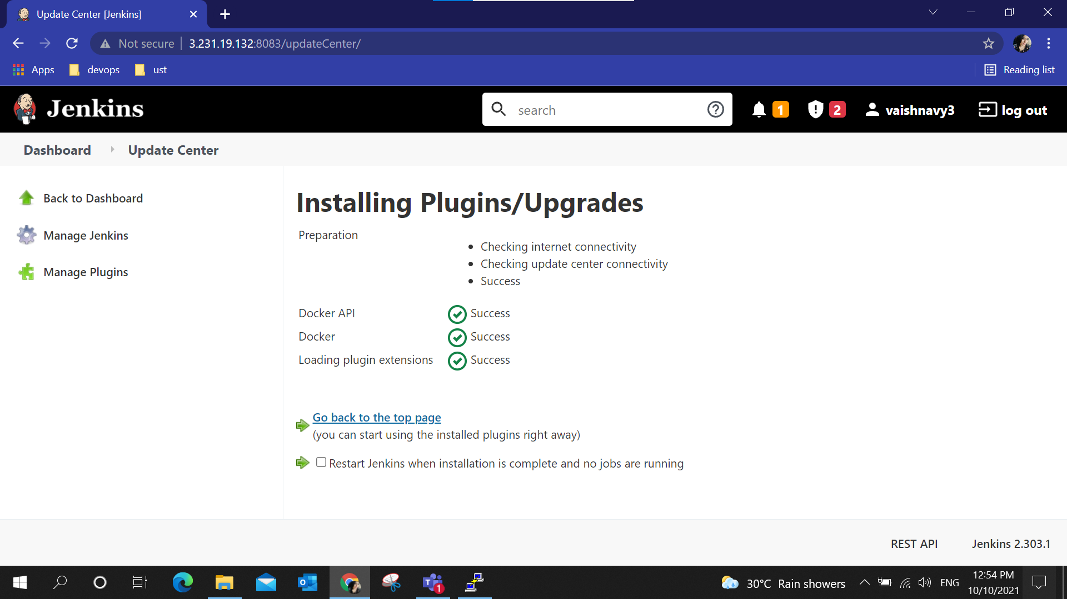
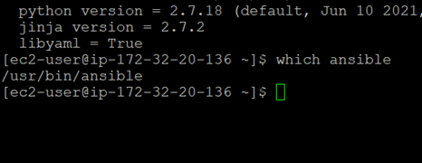

Slide 37
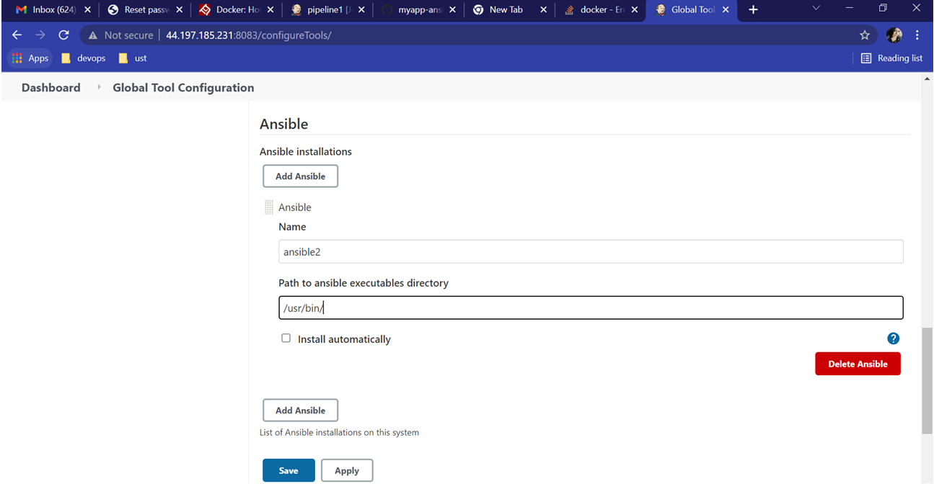

Slide 38
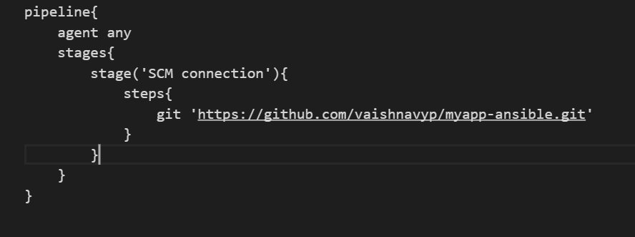
Pipeline

Slide 39
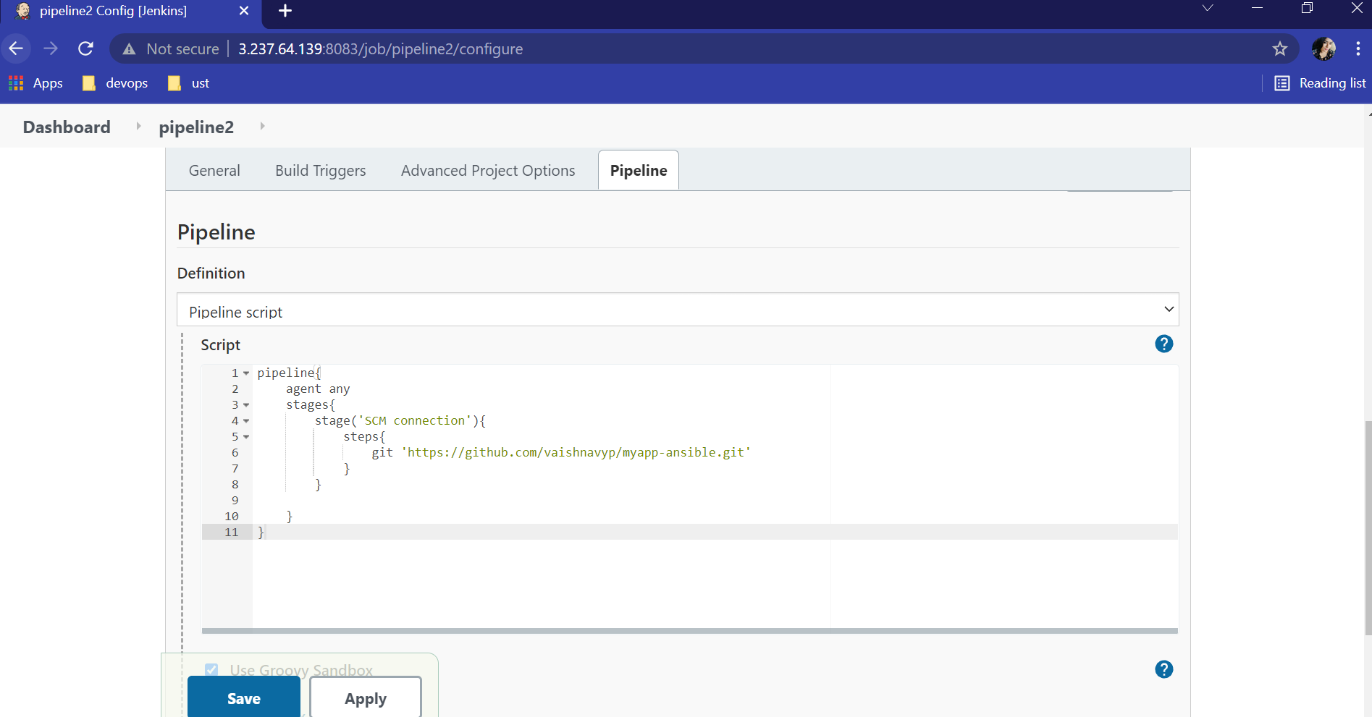
Pipeline script

Slide 40
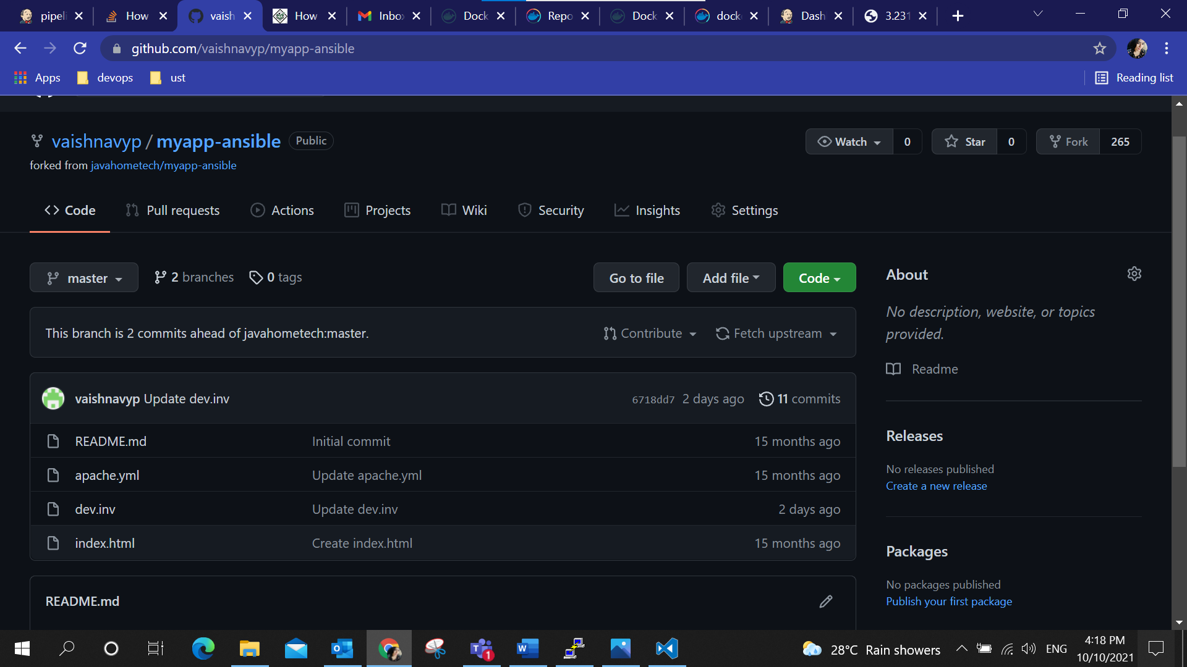
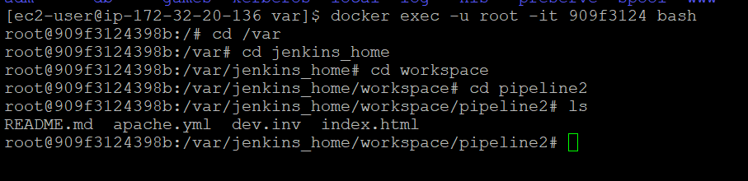
Cloning part of the pipeline is success.

Slide 41
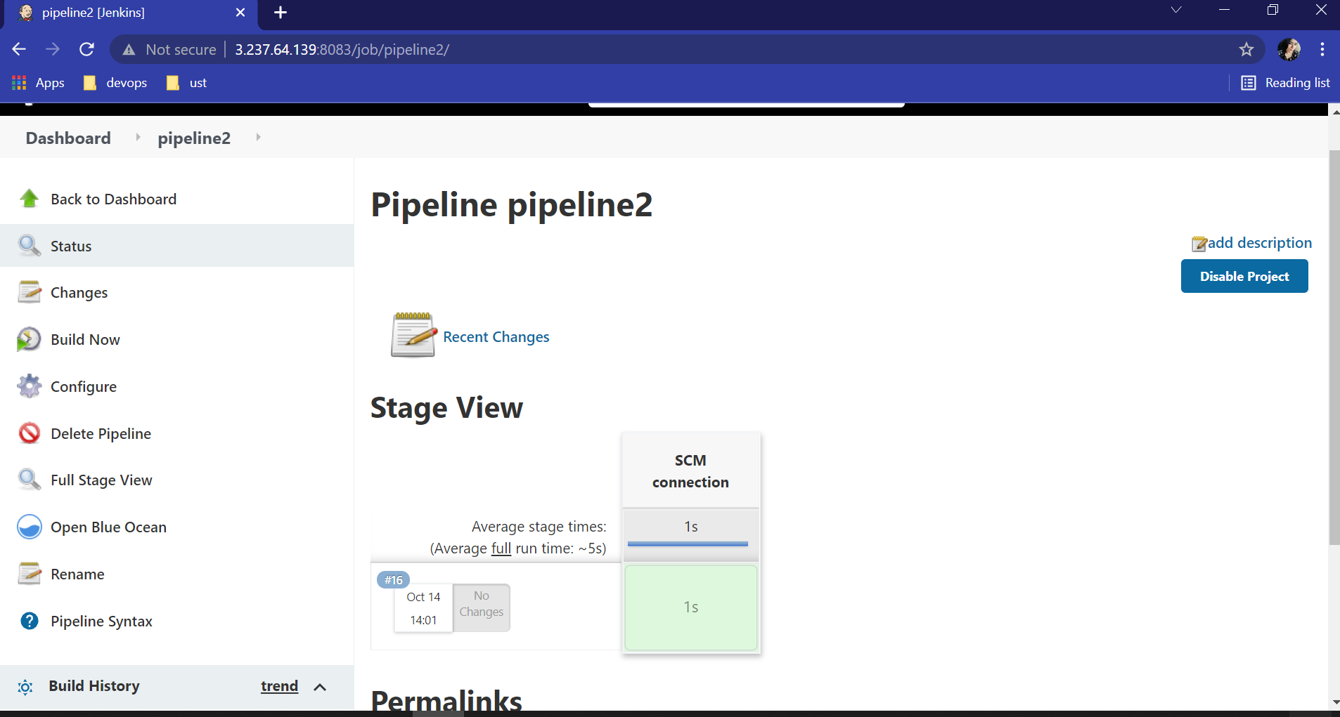
Pipeline build with git part success.

Slide 42
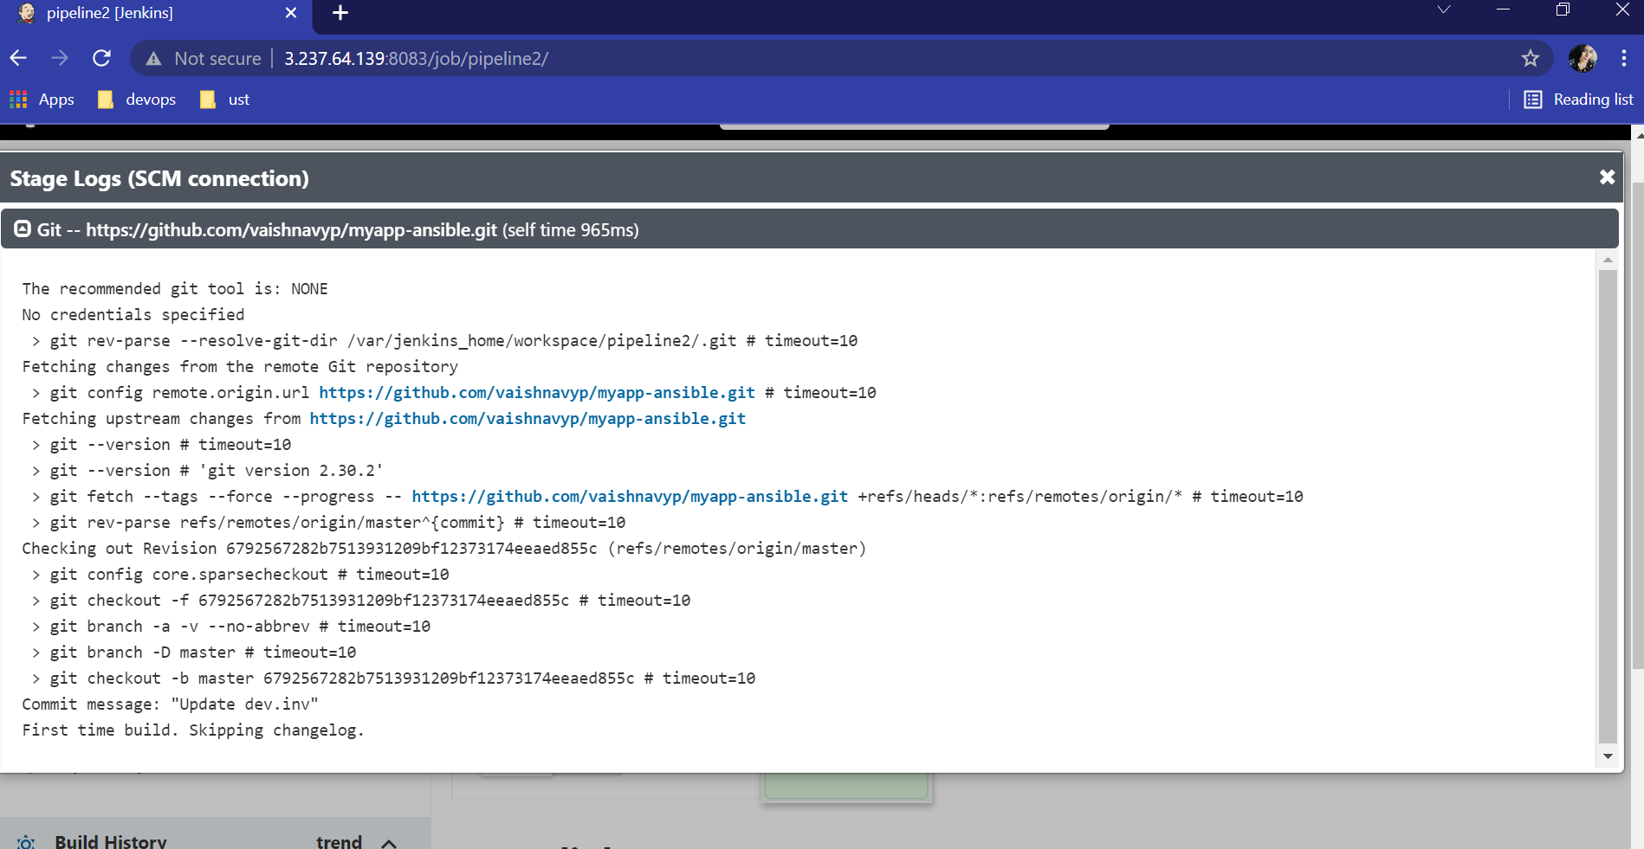

Slide 43
THANK YOU Presented by : Vaishnavy Prakash U-ID: 168225

